Slide 1
Module 4: Models and Theories

Slide 2
COGNITIVE MODELS
Cognitive models represent users of interactive systems.
Emphasis is on formulating aspects of user behaviour such as goal formation, problem solving, understanding, knowledge, intentions or processing
Cognitive model is basically categorised into three categories:
1)Hierarchical representation of the user’s task and goal structure (issue of formulation of goals and tasks)
2) linguistic and grammatical models ( How it is understood by the user, articulation translation)
3) physical and device-level models. (human motor level)

Slide 3
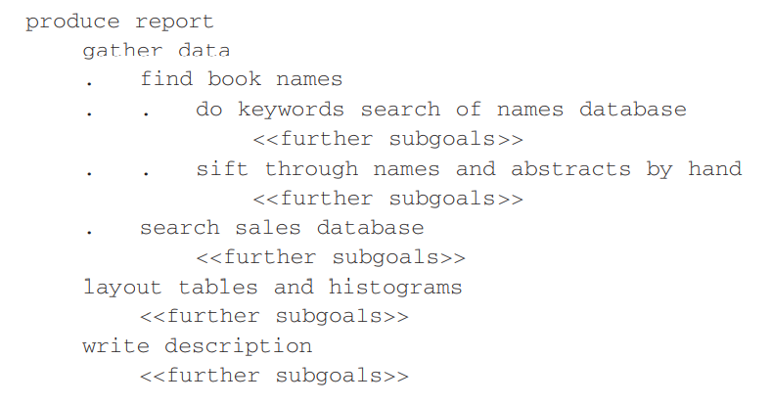
Goal and Task hierarchies
models make use of a model of mental processing in which the user achieves goals by solving subgoals in a divide-and-conquer fashion.

Slide 4
GOMS and CCT, where this is a central feature
GOMS
Goals These are the user’s goals, describing what the user wants to achieve
Operators These are the lowest level of analysis. They are the basic actions that the user must perform in order to use the system.(issue the SELECT command’, move mouse to menu bar, press center mouse button, reading dialog box)
Methods : there are typically several ways in which a goal can be split into subgoals. or instance, example : in a certain window manager a currently selected window can be closed to an icon either by selecting the ‘CLOSE’ option from a pop-up menu, or by hitting the ‘L7’ function key. In GOMS these two goal decompositions are referred to as methods, so we have the CLOSE-METHOD and the L7-METHOD

Slide 5
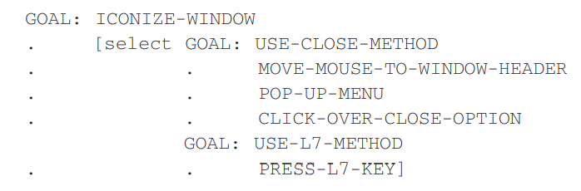
Selection: From the above snippet we see the use of the word select where the choice of methods arises. GOMS does not leave this as a random choice, but attempts to predict which methods will be used
The goal decomposition between the overall task and the unit tasks would involve detailed understanding of the user’s problem-solving strategies and of the application domain

Slide 6
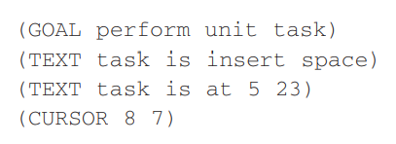
Cognitive Complexity Theory
CCT has two parallel descriptions: one of the user’s goals and the other of the computer system (called the device in CCT)
The description of the user’s goals is based on a GOMS-like goal hierarchy, but is expressed primarily using production rules ( If condition then action)( condition is content of working memory, if condition is true PR is said to fire)
For the system grammar, CCT uses generalized transition networks
imagine that the user has just seen the typing mistake and thus the contents of working memory (w.m.) are

Slide 7
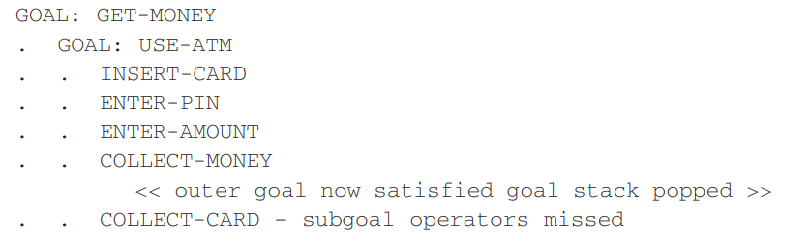
Problems with CCT
As with many ‘rich’ description methods, the size of description for even a part of an interface can be enormous
there may be several ways of representing the same user behavior and interface behavior
Particular choice of notations
Problem of closure in representation

Slide 8
Linguistic models
The user’s interaction with a computer is often viewed in terms of a language
BNF (Backus-Naur Form) grammars are frequently used to specify dialog.
rules to describe the dialog grammar
This views the dialog at a purely syntactic level, ignoring the semantics of the language.

Slide 9
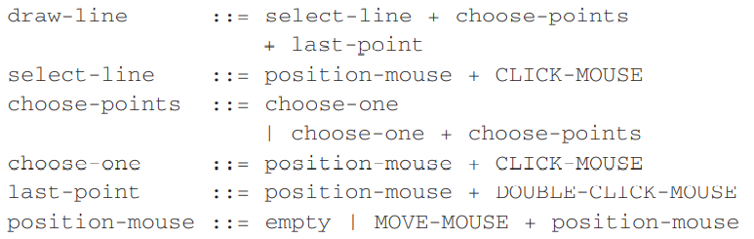
The names in the description are of two types: non-terminals, shown in lower case, and terminals, shown in upper case.
Terminals represent the lowest level of user behavior
The non-terminals are defined in terms of other non-terminals and terminals by a definition of the form
name ::= expression
The ‘::=’ symbol is read as ‘is defined as’
+ ( sequence), |(choice)

Slide 10
The BNF description of an interface can be analyzed in various ways. One measure is to count the number of rules.
The more rules an interface requires to use it, the more complicated it is.
The BNF description above only represented the user’s actions, not the user’s perception of the system’s responses

Slide 11
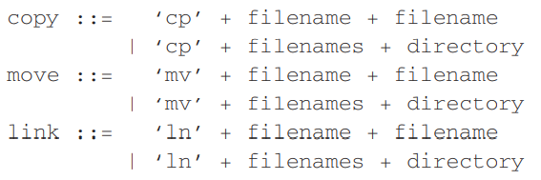
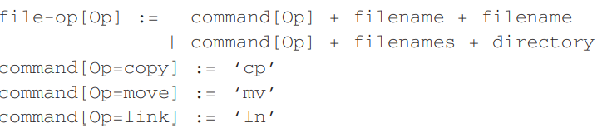
Task Action Grammar ( TAG)
Including element of parameterized grammar rules [].
Emphasize on consistency
Example : consider mv, cp, ln

Slide 12
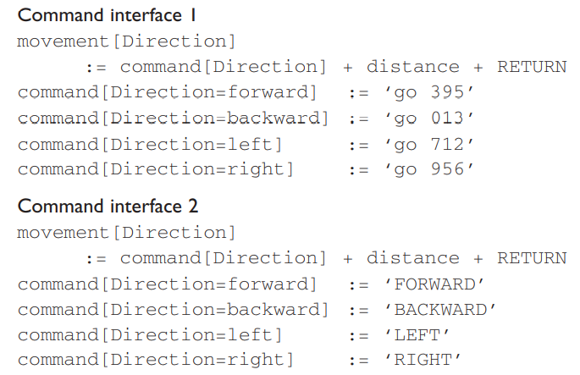
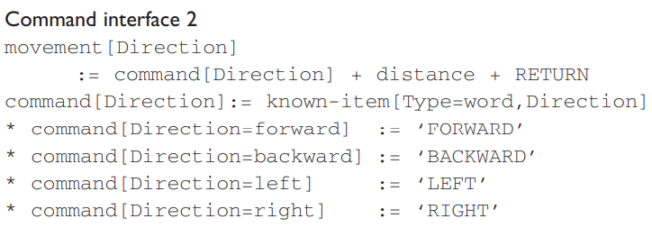

Slide 13
PHYSICAL AND DEVICE MODELS
Keystroke-Level Model ( KLM) uses understanding as a basis for detailed predictions about user performance
It is aimed at unit tasks within interaction – the execution of simple command sequences, typically taking no more than 20 seconds
Examples of this would be using a search and replace feature, or changing the font of a word
The task is split into two phases:
acquisition of the task, when the user builds a mental representation of the task;
execution of the task using the system’s facilities

Slide 14
The model decomposes the execution phase into five different physical motor operators, a mental operator and a system response operator:
K Keystroking, actually striking keys, including shifts and other modifier keys.
B Pressing a mouse button.
P Pointing, moving the mouse (or similar device) at a target
H Homing, switching the hand between mouse and keyboard. D Drawing lines using the mouse.
M Mentally preparing for a physical action.
R System response which may be ignored if the user does not have to wait for it.

Slide 15
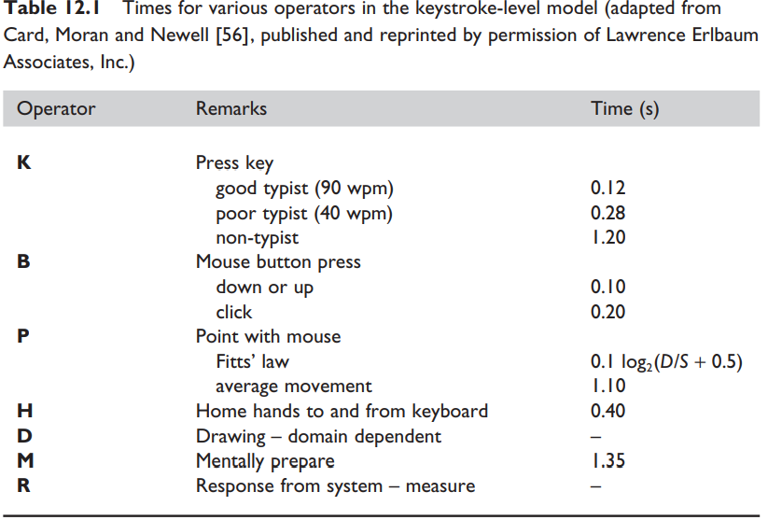
The model predicts the total time taken during the execution phase by adding the component times for each of the above activities
Texecute = TK + TB + TP + TH + TD + TM + TR
= 2tK + 2tB + 2tP + 3tH + 0 + 2tM + 0

Slide 16
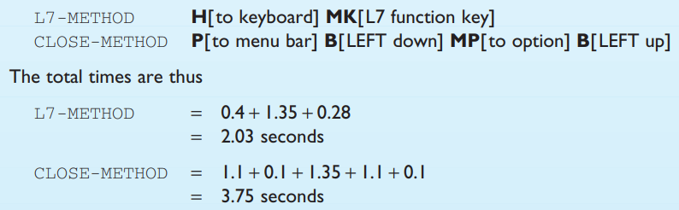

Slide 17
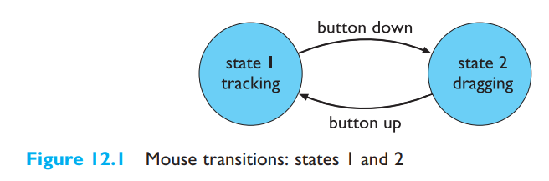
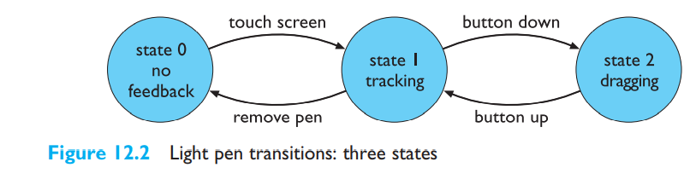
Three-state model
Buxton has developed a simple model of input devices ( pointing devices), the three-state model, which captures some of these crucial distinctions

Slide 18
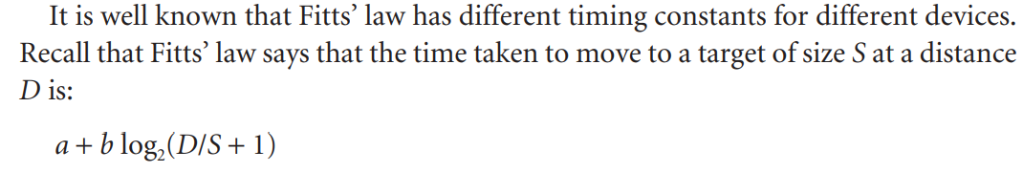
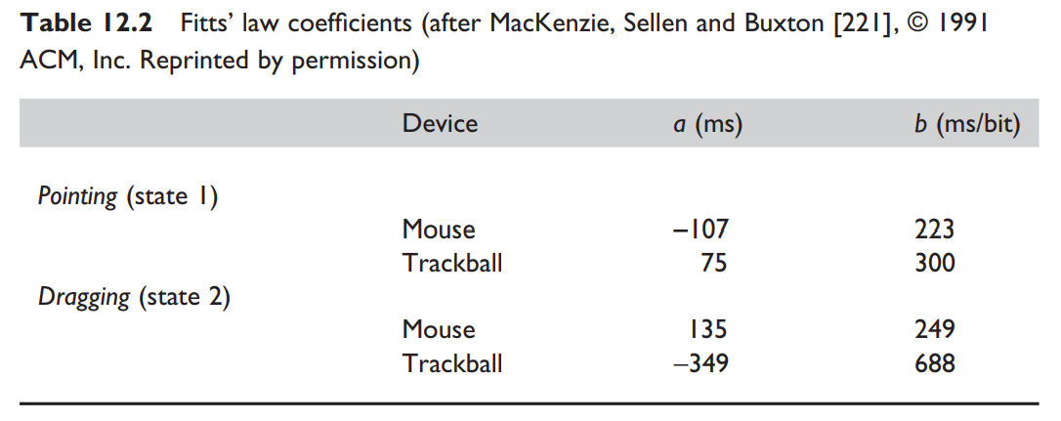

Slide 19
COGNITIVE ARCHITECTURES
The problem Space model
Rational behavior is characterized as behavior that is intended to achieve a specific goal.
This element of rationality is often used to distinguish between intelligent and machine-like behavior
In the field of artificial intelligence (AI), a system exhibiting rational behavior is referred to as a knowledge-level system ( other is expert system)
A knowledge-level system contains an agent behaving in an environment.
A problem space consists of a set of states and a set of operations that can be performed on the states.
A problem space represents a goal by defining the desired states as a subset of all possible states. Once the initial state is set, the task within the problem space is to find a sequence of operations that form a path within the state space from the initial state to one of the desired states, whereupon successful termination occurs.

Slide 20
four different activities that occur within a problem space: goal formulation, operation selection, operation application and goal completion
Interacting Cognitive subsystems
ICS provides a model of perception, cognition and action
emphasis is on determining how easy particular procedures of action sequences become as they are made more automatic within the user.
ICS attempts to incorporate two separate psychological traditions within one cognitive architecture. On the one hand is the architectural and general-purpose information-processing approach of short-term memory research. On the other hand is the computational and representational approach characteristic of psycho-linguistic research

Slide 21
The architecture of ICS is built up by the coordinated activity of nine smaller subsystems: five peripheral subsystems are in contact with the physical world and four are central, dealing with mental processes.
A subsystem is described in terms of its typed inputs and outputs along with a memory store for holding typed information

Slide 22
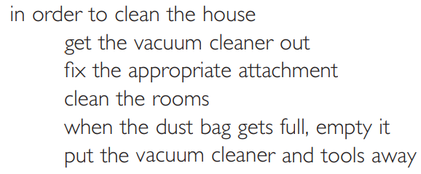
Task Analysis
Task analysis is the process of analyzing the way people perform their jobs: the things they do, the things they act on and the things they need to know
three different approaches to task analysis:
Task decomposition which looks at the way a task is split into subtasks, and the order in which these are performed.
Knowledge-based techniques which look at what users need to know about the objects and actions involved in a task, and how that knowledge is organized.
Entity–relation-based analysis which is an object-based approach where the emphasis is on identifying the actors and objects, the relationships between them and the actions they perform.

Slide 23
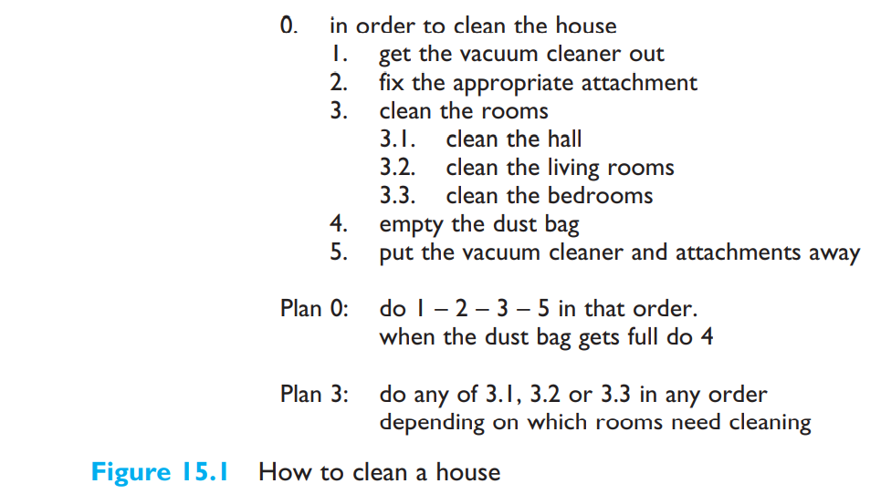
Task decomposition:
Example of vacuum cleaning: Hierarchical task analysis ( HTA)
The outputs of HTA are a hierarchy of tasks and subtasks and also plans describing in what order and under what conditions subtasks are performed.

Slide 24
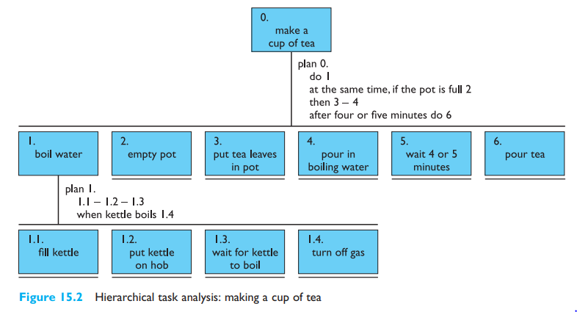

Slide 25
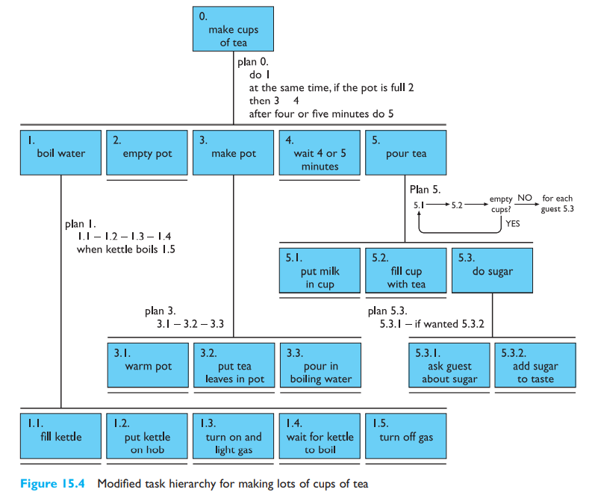

Slide 26
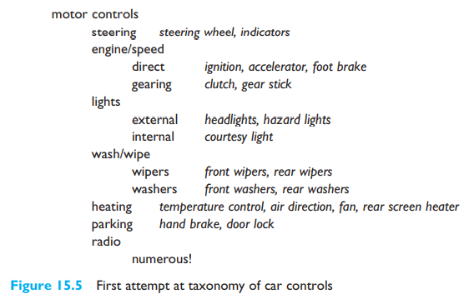
KNOWLEDGE-BASED ANALYSIS
Knowledge-based task analysis begins by listing all the objects and actions involved in the task, and then building taxonomies of them

